Slide 1

Fast-Transient Low-Dropout Regulator

Slide 2
Bandgap Reference Circuit
By: Golden Volt Team
Mohamed Essam
Bilal Ramadan
Morad Saad
Hazem Mostafa

Slide 3
Agenda
Introduction
Design Methodology
Design Challenges
Design Specs
Simulation Results

Slide 4
Introduction
BGR desired behavior
Constant voltage
Immune to PVT
Small area
Low power consumption
Fast startup
Trimming and calibration ability
2/14

Slide 5
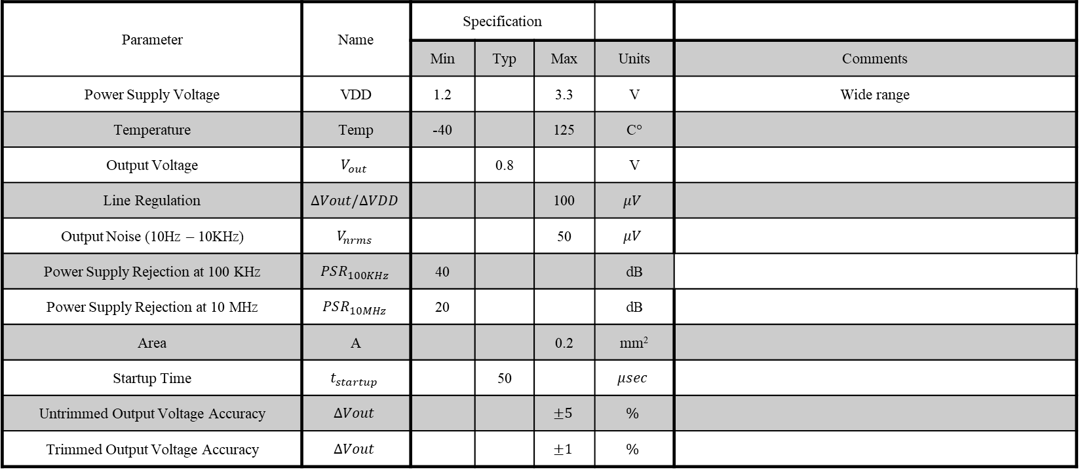
Design Specs
Parameter | Name | Specification
 |  | Min | Typ | Max | Units | Comments
Power Supply Voltage | VDD | 1.2 |  | 3.3 | V | Wide range
Temperature | Temp | -40 |  | 125 | C$°$
Output Voltage | $$V_{out}$$ |  | 0.8 |  | V
Line Regulation | $$∆Vout/∆VDD$$ |  |  | 100 | $$μV$$
Output Noise (10Hz – 10KHz) | $$V_{nrms}$$ |  |  | 50 | $$μV$$
Power Supply Rejection at 100 KHz | $$PSR_{100KHz}$$ | 40 |  |  | dB
Power Supply Rejection at 10 MHz | $$PSR_{10MHz}$$ | 20 |  |  | dB
Area | A |  |  | 0.2 | mm²
Startup Time | $$t_{startup}$$ |  | 50 |  | $$μsec$$
Untrimmed Output Voltage Accuracy | $$∆Vout$$ |  |  | $$±5$$ | $$\%$$
Trimmed Output Voltage Accuracy | $$∆Vout$$ |  |  | $$±1$$ | $$\%$$
3/14

Slide 6
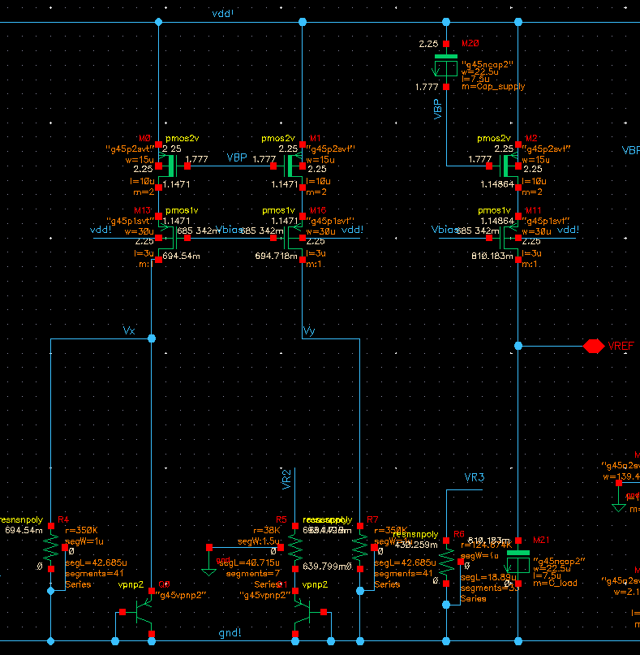

Design Methodology (Core design)
Topology
Why Cascode and banba architecture?
Devices flavors
Mosfets and BJTs
Resistors values
$R_{4,7}$ define the current consumption
Tuning such that $R_{5}≈\frac{PTAT voltage slope}{CTAT voltage slope}∗R_{7,4}$
Choose $R_{6}$ such that $V_{REF}=800 mV$
Capacitors flavor and values
Stability, PSR and startup time
4/14

Slide 7
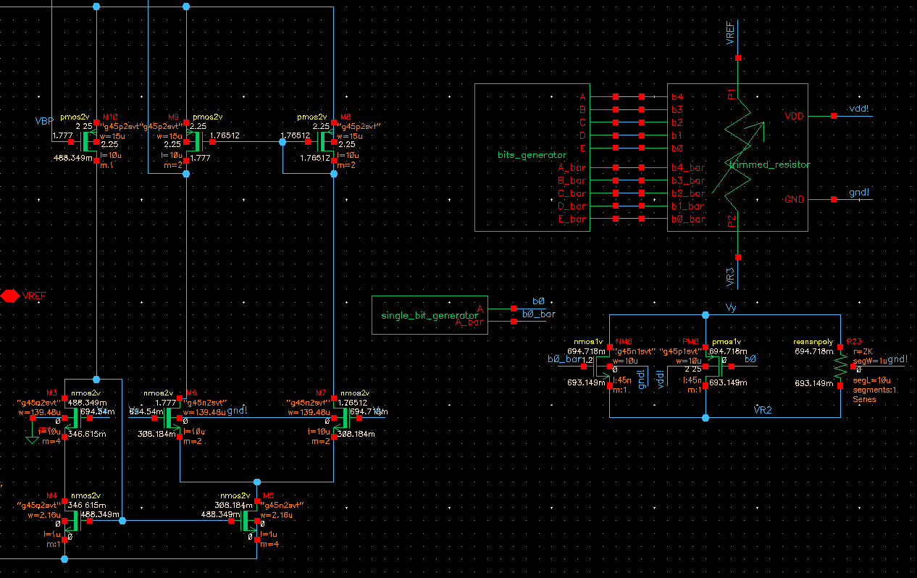
Design Methodology (OTA design)
Topology
Why NMOS input pair 5T-OTA?
Self-biasing branch
5/14

Slide 8
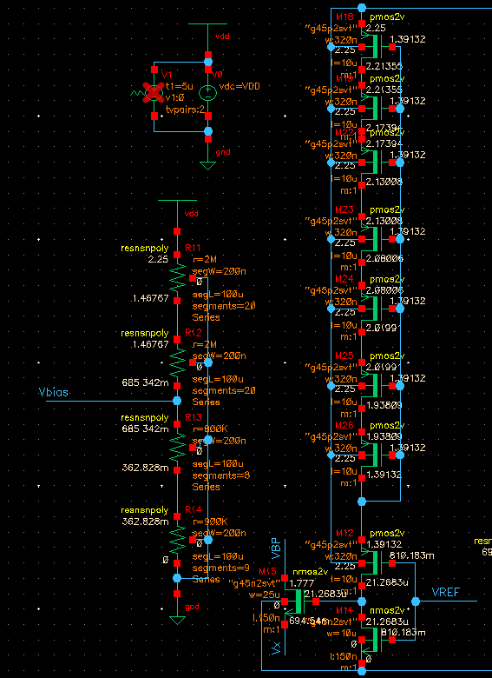
Design Methodology (Startup design)
Startup circuit
Biasing branch
5/14

Slide 9
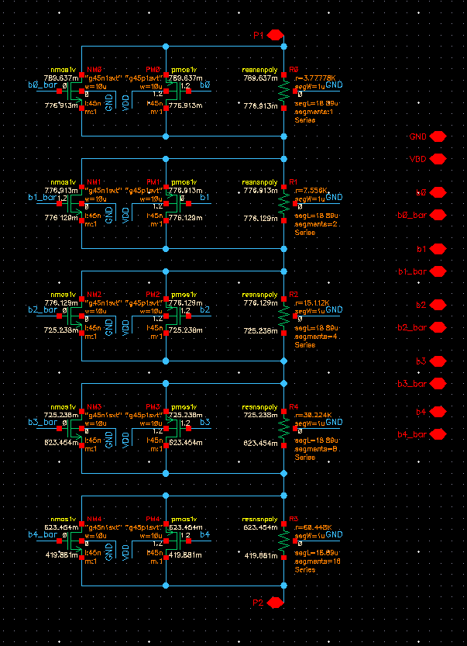

Design Methodology (Trimming)
Single-bit $R_{5}$ trimming (Temperature Coeff.)
5-bits $R_{6}$ trimming
12.5mV step
5/14

Slide 10
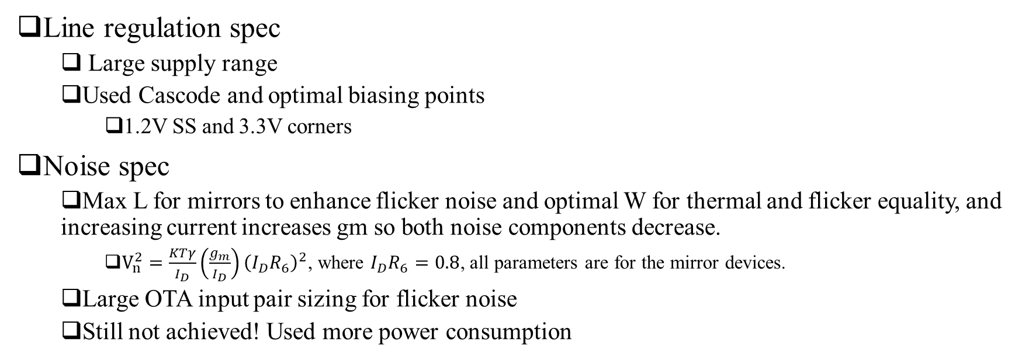
Design Challenges
Line regulation spec
Large supply range
Used Cascode and optimal biasing points
1.2V SS and 3.3V corners
Noise spec
Max L for mirrors to enhance flicker noise and optimal W for thermal and flicker equality, and increasing current increases gm so both noise components decrease.
$V_{n}^{2}=\frac{KTγ}{I_{D}}\left(\frac{g_{m}}{I_{D}}\right){\left(I_{D}R_{6}\right)}^{2}$, where $I_{D}R_{6}=0.8$, all parameters are for the mirror devices.
Large OTA input pair sizing for flicker noise
Still not achieved! Used more power consumption
6/14

Slide 11
Simulation Results

Slide 12
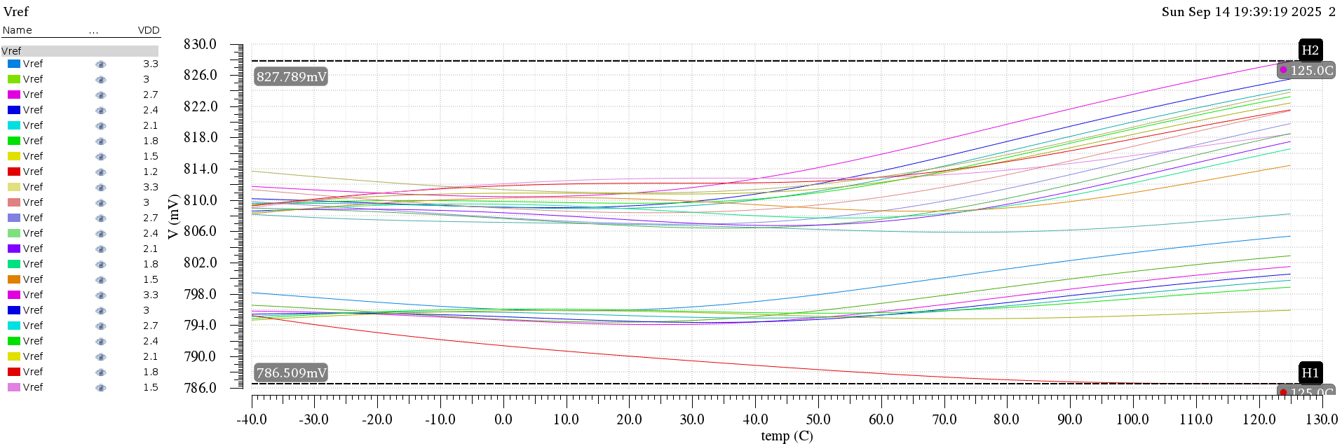
Untrimmed output variations vs temperature
6/14

Slide 13
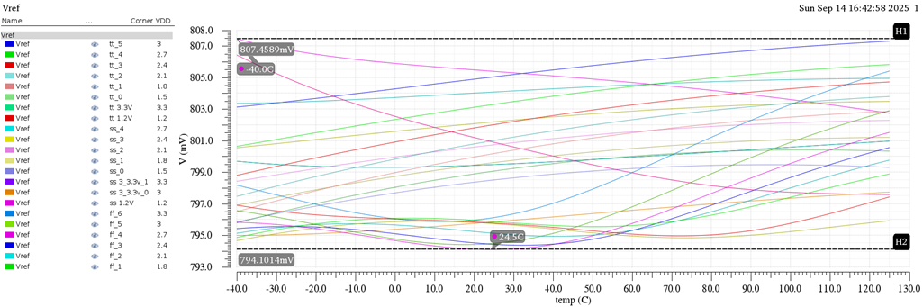
Trimmed output variations vs temperature
6/14

Slide 14
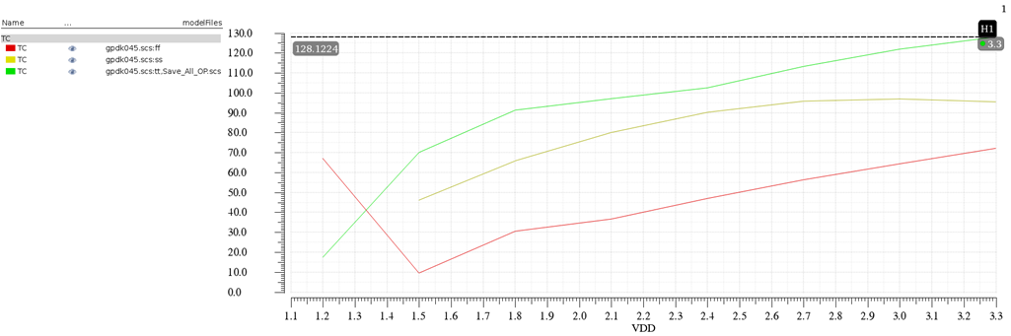
Untrimmed TC corners (in ppm/ºC) vs VDD
tt
ff
ss
6/14

Slide 15
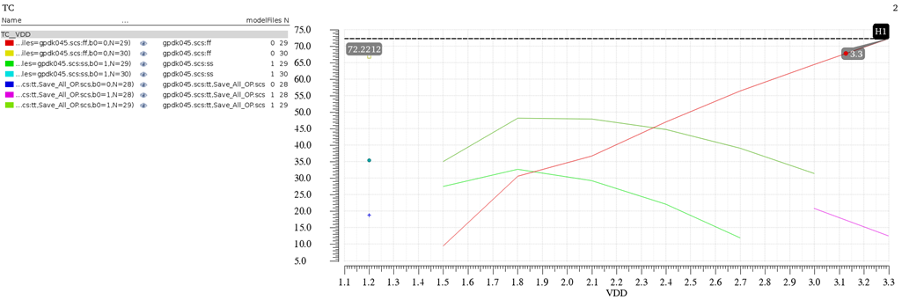
Trimmed TC corners (in ppm/ºC) vs VDD
6/14

Slide 16
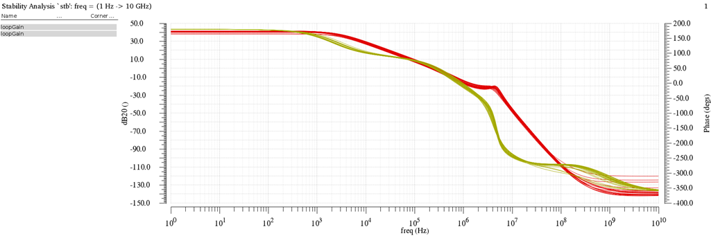
Loop gain corners vs frequency
Loop gain magnitude (in dB)
Loop gain phase (in degrees)
6/14

Slide 17
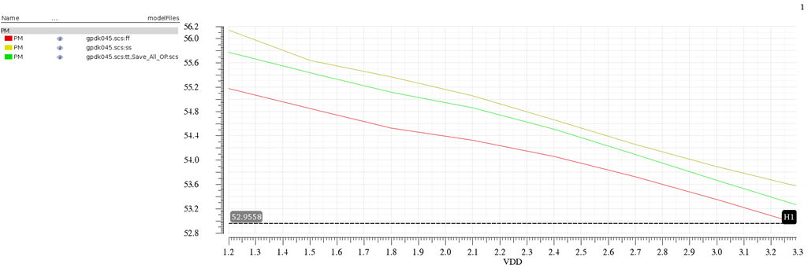
PM corners (in degrees) vs VDD
tt
ff
ss
6/14

Slide 18
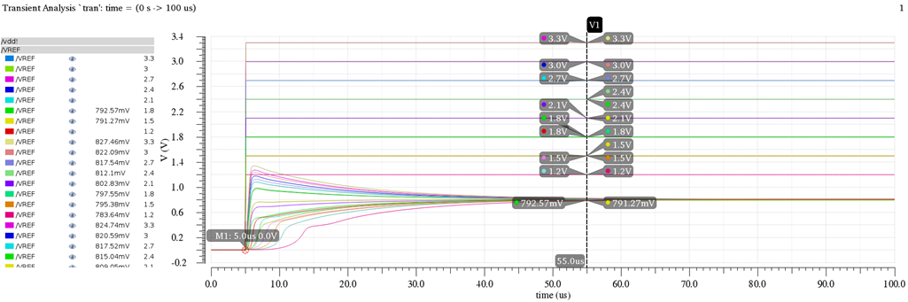
Output startup time
6/14

Slide 19
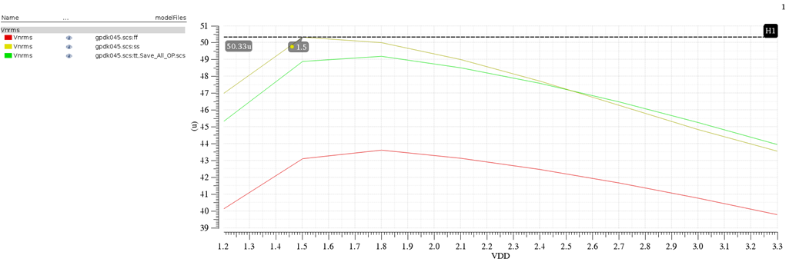
Vnrms corners (in V) vs VDD
tt
ff
ss
6/14

Slide 20
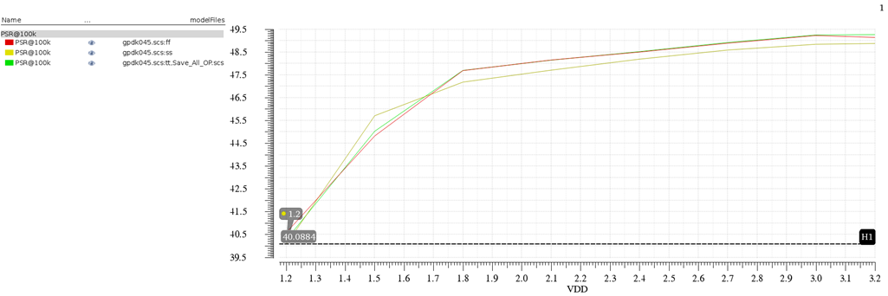
PSR @100 KHz corners (in dB) vs VDD
tt
ff
ss
6/14

Slide 21
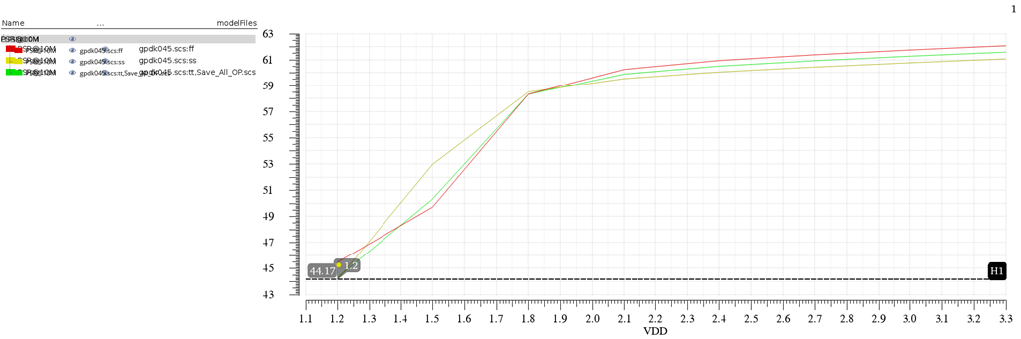
PSR @10 MHz corners (in dB) vs VDD
tt
ff
ss
6/14

Slide 22
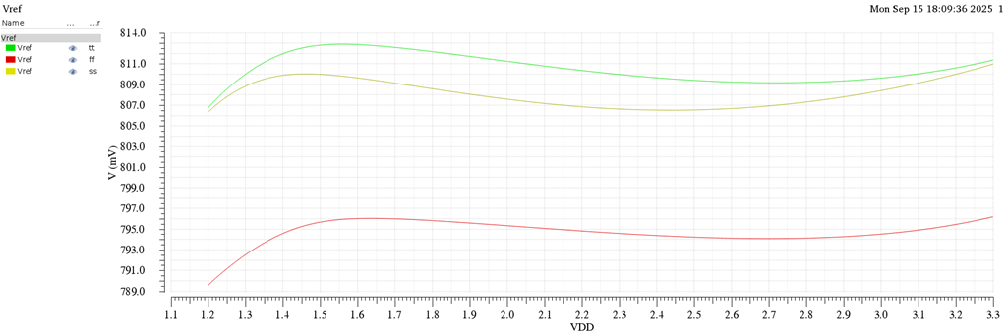
Line regulation corners
tt
ff
ss
6/14

Slide 23
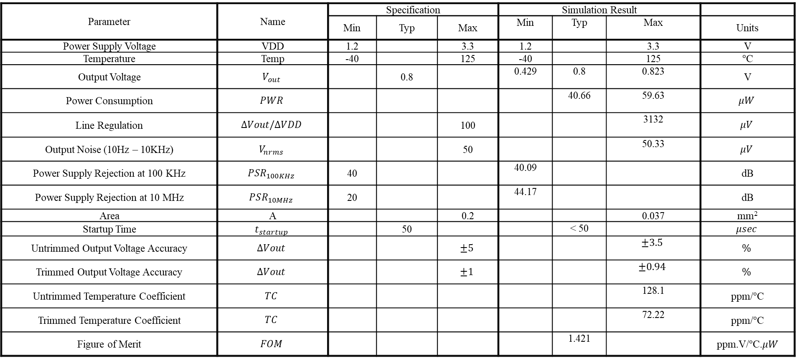
Achieved Specs
Parameter | Name | Specification |  |  | Simulation Result
 |  | Min | Typ | Max | Min | Typ | Max | Units
Power Supply Voltage | VDD | 1.2 |  | 3.3 | 1.2 |  | 3.3 | V
Temperature | Temp | -40 |  | 125 | -40 |  | 125 | $°$C
Output Voltage | $$V_{out}$$ |  | 0.8 |  | 0.429 | 0.8 | 0.823 | V
Power Consumption | $$PWR$$ |  |  |  |  | 40.66 | 59.63 | $$μW$$
Line Regulation | $$∆Vout/∆VDD$$ |  |  | 100 |  |  | 3132 | $$μV$$
Output Noise (10Hz – 10KHz) | $$V_{nrms}$$ |  |  | 50 |  |  | 50.33 | $$μV$$
Power Supply Rejection at 100 KHz | $$PSR_{100KHz}$$ | 40 |  |  | 40.09 |  |  | dB
Power Supply Rejection at 10 MHz | $$PSR_{10MHz}$$ | 20 |  |  | 44.17 |  |  | dB
Area | A |  |  | 0.2 |  |  | 0.037 | mm²
Startup Time | $$t_{startup}$$ |  | 50 |  |  | < 50 |  | $$μsec$$
Untrimmed Output Voltage Accuracy | $$∆Vout$$ |  |  | $$±5$$ |  |  | $$±3.5$$ | $$\%$$
Trimmed Output Voltage Accuracy | $$∆Vout$$ |  |  | $$±1$$ |  |  | $$±0.94$$ | $$\%$$
Untrimmed Temperature Coefficient | $$TC$$ |  |  |  |  |  | 128.1 | ppm/$°$C
Trimmed Temperature Coefficient | $$TC$$ |  |  |  |  |  | 72.22 | ppm/$°$C
Figure of Merit | $$FOM$$ |  |  |  |  | 1.421 |  | ppm.V/$°$C.$μW$
6/14

Slide 24

Thank You
For the detailed report
Presented by
Mohamed Essam
Bilal Ramadan
Morad Saad
Hazem Mostafa
14/14

